Slide 1

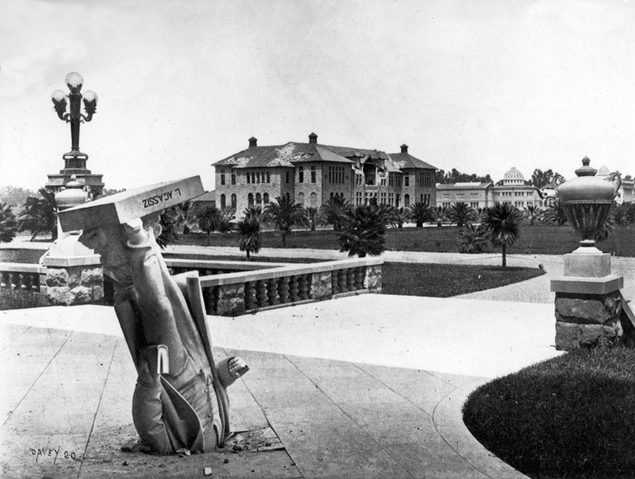
Topic 10
Abstract Classes
“I prefer Agassiz in the abstract,
rather than in the concrete.”

Slide 2
Back to the Property Example
There are properties on a monopoly board
Railroads, Utilities, and Streets are kinds of properties
One behavior we want in Property is the getRent method
problem: How do I get the rent of something that is “just a Property”?
CS314
Abstract Classes

Slide 3
The Property class
public class Property {
private int cost;
private String name;
public int getRent() {
return hmmmmm?????
}
Doesn’t seem like we have enough information to
get the rent if all we know is it is a Property.
CS314
Abstract Classes

Slide 4
Potential Solutions
Just leave it for the sub classes.
  Have each sub class define getRent()
Define getRent() in Property and simply return -1.
  Sub classes override the method with more meaningful behavior.
CS314
Abstract Classes

Slide 5
Leave it to the Sub - Classes
// no getRent() in Property
// Railroad and Utility DO have getRent() methods
public void printRents(Property[] props) {
for(Property p : props)
System.out.println(p.getRent());
}
Property[] props= new Property[2];
props[0] = new Railroad("NP", 200, 1);
props[1]
= new Utility("Electric", 150, false);
printRents(props);
What is result of above code?
A. 200150 B. different every time
C. Syntax error D. Class Cast Exception
E. Null Pointer Exception
CS314
Abstract Classes

Slide 6
Fix by Casting
// no getRent() in Property
public void printRents(Property[] props)
{
for(Property p : props)
{ if(p instanceof Railroad)
System.out.println( ((Railroad)).getRent() );
else if(p instanceof Utility)
System.out.println( ((Utility)p).getRent() );
}
}
Property[] props= new Property[2];
props[0] = new Railroad("NP", 200, 1);
props[1] = new Utility("Electric", 150, false);
printRents( props);
What happens as we add more sub classes of Property?
What happens if one of the objects is just a Property?
CS314
Abstract Classes

Slide 7
Fix with Dummy Method
// getRent() in Property returns -1
public void printRents(Property[] props) {
for(Property p : props)
System.out.println(p.getRent());
}
Property[] props= new Property[2];
props[0] = new Railroad("NP", 200, 1);
props[1] = new Utility("Electric", 150, false);
printRents( props);
What happens if sub classes don’t override getRent()?
Is that a good answer?
CS314
Abstract Classes

Slide 8
A Better Fix
We know we want to be able to find the rent of objects that are instances of Property
The problem is we don’t know how to do that if all we know is it a Property
Make getRent an abstract method
Java keyword
CS314
Abstract Classes

Slide 9
Making getRent Abstract
public class Property {
private int cost;
private String name;
public abstract int getRent();
// I know I want it.
// Just don’t know how, yet…
}
Methods that are declared abstract have no body
an undefined behavior.
All methods in a Java interface are abstract.
CS314
Abstract Classes

Slide 10
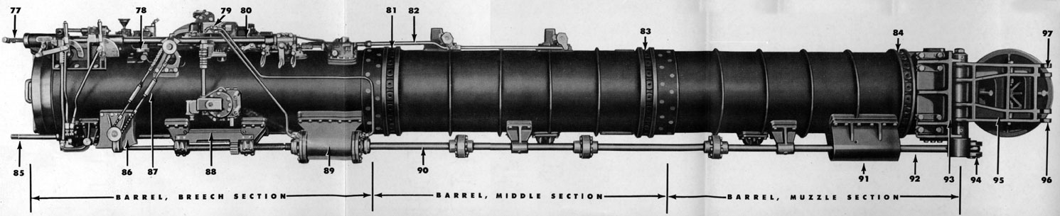
Problems with Abstract Methods
Given getRent() is now an abstract method what is wrong with the following code?
Property s = new Property();
System.out.println(s.getRent());
CS314
Abstract Classes

Slide 11
Undefined Behavior = Bad
Not good to have undefined behaviors
If a class has 1 or more abstract methods, the class must also be declared abstract.
  version of Property shown would cause a compile error
Even if a class has zero abstract methods a programmer can still choose to make it abstract
  if it models some abstract thing
  is there anything that is just a “Mammal”?
CS314
Abstract Classes

Slide 12
Abstract Classes
public abstract class Property {
private int cost;
private String name;
public abstract double getRent();
// I know I want it.
// Just don’t know how, yet…
}
// Other methods not shown
f a class is abstract the compiler will not allow constructors of that class to be called
Property s = new Property(1, 2);
//syntax error
CS314
Abstract Classes

Slide 13
Abstract Classes
In other words you can’t create instances of objects where the lowest or most specific class type is an abstract class
Prevents having an object with an undefined behavior
Why would you still want to have constructors in an abstract class?
Object variables of classes that are abstract types may still be declared
  Property s; //okay
CS314
Abstract Classes

Slide 14
Sub Classes of Abstract Classes
Classes that extend an abstract class must provided a working version of any abstract methods from the parent class
  or they must be declared to be abstract as well
  could still decide to keep a class abstract regardless of status of abstract methods
CS314
Abstract Classes

Slide 15
Implementing getRent()
public class Railroad extends Property {
private static int[] rents
= {25, 50, 10, 200};
private int numOtherRailroadsOwned;;
public double getRent() {
return rents[numOtherRailroadsOwned];}
// other methods not shown
}
CS314
Abstract Classes

Slide 16
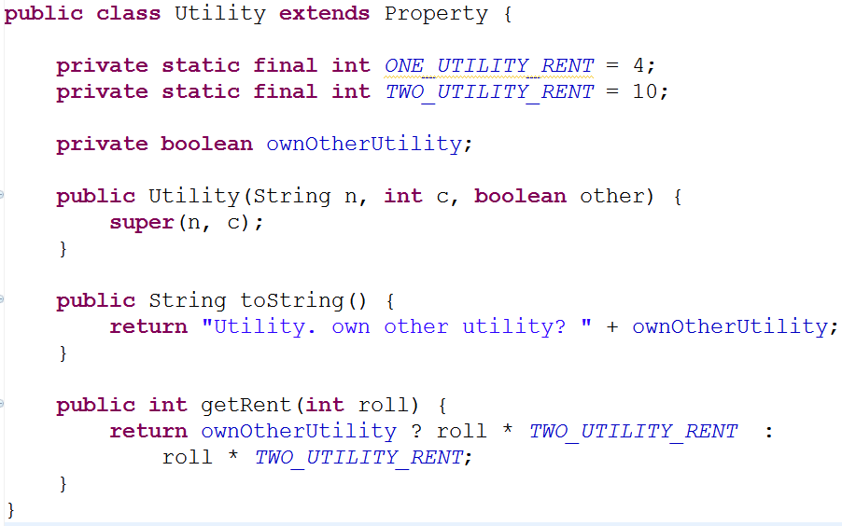
A Utility Class
CS314
Abstract Classes

Slide 17
Polymorphism in Action
// getRent() in Property is abstract
public void printRents(Property[] props) {
for(Property p : props)
System.out.println(p.getRent());
}
Add the Street class. What needs to change in printRents method?
Inheritance is can be described as new code using old code.
Polymorphism can be described as old code using new code.
CS314
Abstract Classes

Slide 18
Comparable in Property
public abstract class Property
implements Comparable<Property> {
private int cost;
private String name;
public abstract int getRent();
public int compareTo(Property other) {
return this.getRent()
– otherProperty.getRent();
}
}
CS314
Abstract Classes

Slide 19
Back to Lists
We suggested having a list interface
public interface IList<E> extends Iterable<E> {
public void add(E value);
public int size();
public E get(int location);
public E remove(int location);
public boolean contains(E value);
public void addAll(List<E> other);
public boolean containsAll(List<E> other);
}
CS314
Abstract Classes

Slide 20
Data Structures
When implementing data structures:
Specify an interface
Create an abstract class that is skeletal implementation interface
Create classes that extend the skeletal interface
CS314
Abstract Classes

